Slide 1
tare-csv
Terminal Application Read / Edit
Comma Separated Values
Evelyn Paplauskas
https://github.com/evey-pea/T1A2

Slide 2
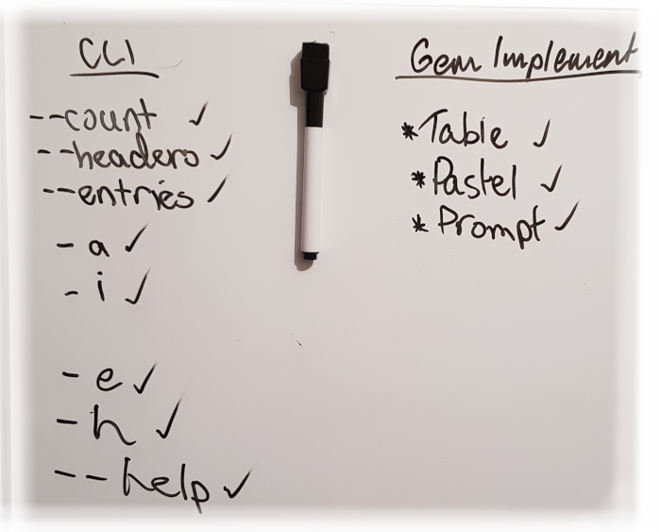
Build Workflow Design
As the project was a freeform design, workflow was kept simple by following these steps
Establish the program idea in a reference document (README.md)
Write out in detail each individual option the user had available in the document
Write down each of the gems to be used
Based on how each part of the implementation of the build performed, re-evaluate the program features, scope, functions and required components
Upon each re-evaluation, update the documentation accordingly

Slide 3
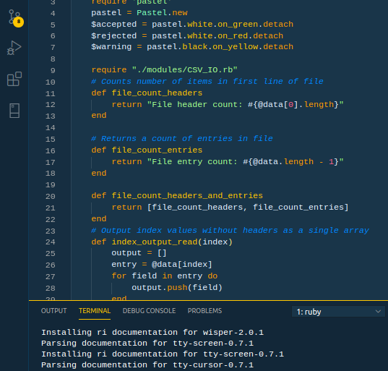
Build Workflow Implementation
The initial part of the build was the main program class and the command line logic
The command line logic was then moved to its own module to reduce code in the main file for better readability.
Each feature of the application was coded one after the other.
For testing purposes, test data was used locally in each file for testing each method
Once all the methods for each module was deemed working, it was linked in to the main program and tested once again

Slide 4
User options and program flow
User calls program from terminal
Error Message in terminal advising incorrect arguments
File Not
Saved
File
Saved
User is prompted to confirm 'save'
Requested information from file is read out to the terminal
Arguments
checked
Use is prompted for new values
Command line logic determines if output goes straight to the terminal or if edit mode is to be used
FIle specified is read into program
Edit mode:
Entry for editing is displayed on screen

Slide 5
Personal Benefits from the project
Learnings
Favourite Milestones and Parts
Reading and writing files in Ruby is sometimes better done in pure core Ruby standard constructs rather than relying gems
The difficulty of implementing a gem is directly proportionate to amount of documentation available for the gem
Modules are awesome for the DRY principle
Checking what data (and its structure) has been passed to a method is the best thing to do first when debugging errors
Sithu Aye has some awesome albums that are great to use as a mental focus tool
When code just worked without having to debug an error (it was a rare and welcome sight)
Getting the ARGV parsing logic right for the command line (This made things so much easier to integrate later on)
Working out how to transpose multidimensional arrays
Working with the pastel gem –using aliases made putting together preset themed colours so much easier than doing it manually
Sleeping after it was finished
Waking up and realising I wrote approximately 320 lines of freeform refactored code in four days – a new P.B.

